Slide 1
FAULT PROGNOSIS IN POWER CONVERTER CIRCUIT
GUIDE: DR.M.SATHIYANATHAN BATCH MEMBERS
BAASKAR R 715519105301
GOWTHAMAN K 715519105302
NICK SALTER S 715519105307
SANJAY S 715519105311

Slide 2
LITERATURE SURVEY
1.1 INTRODUCTION
Many methods have been developed to estimate health and predict failures of mechanical systems . However, failure prediction in electronics is made challenging by the presence of component tolerances, interdependency of electronic components, and the complex nature of fault mechanisms. The existing literature is classified and reviewed based on the approach employed for the failure prediction.
1.2 HEALTH ESTIMATION AND REMAINING USEFUL PREDICTION OF ELECTRONIC CIRCUIT WITH A PARAMETRIC FAULT
Arvind Sai Sarathi Vasan, proposed a method to predict the parametric fault (such a failure in capacitor, resistors etc,)which is going to occur in the circuit or the system and the remaing healhy life of that component is predicted using a kernel-based machine learning

Slide 3
1.3 VIBRATION SIGNAL-BASED EARLY FAULT PROGNOSIS
Weidong Li designed a fault diagnosis method is through scrutinising condition monitoring signals from some key components of industrial systems reflecting the characteristic changes of the systems . The signals include vibration signals , acoustic emission signals , current signals , and temperature signals Vibration signals have been popularly used, as abnormal vibrations can reveal the underlying physical phenomena of the monitored components to indicate damage and faults
1.4 REVIEW ON FAULT-DIAGNOSIS AND FAULT TOLERANCE
FOR DC–DC CONVERTERS
Geddam Kiran Kumar, Devaraj Elangovan developed this method Power switches are the most fragile components in converter circuits, which inherently fall prey to the faults occurring in the system. Hence, there is always a requirement to take appropriate remedial measures to deal with all kinds of faults. Further, in order to detect the occurrence of fault a fast fault diagnosis and fault-tolerant strategies in the DC–DC converters is mandatory and the same has to be embedded in the converter for safety purpose. In view of the importance of the same, the fault-diagnostic algorithms and fault-tolerant strategies have been developed in this literature.

Slide 4
1.5 AN INDUSTRIAL FAULT DIAGNOSIS SYSTEM BASED ON BAYESIAN NETWORKS
Abdelkabir BACHA & Jamal BENHRA proposed this paper to presents a DC motor fault diagnosis system based on Bayesian networks. The data collection will help us in the construction of Bayesian networks models. These data are collected from sensors measuring different types of variables that are directly related to the industrial system. Without doing any mathematical modeling that describes the physical properties of the studied DC motor, the proposed tool provides with the help of Bayesian networks parameters and structure learning algorithms.
1.6 MODEL-BASED FAULT DIAGNOSIS IN ELECTRIC DRIVES USING MACHINE LEARNING
A simulation model has been developed based on the theoretical foundations of electric drives to simulate the normal condition, all single-switch and post-short-circuit faults.A machine learning algorithm has been developed to automatically select a set of representative operating points in the (torque, speed) domain, which in turn is sent to the simulated electric drive model to generate signals for the training of a diagnostic neural network, fault diagnostic neural network (FDNN). We validated the capability of the FDNN on data generated by an experimental bench setup. Our research demonstrates that with a robust machine learning approach, a diagnostic system can be trained based on a simulated electric drive model, which can lead to a correct classification of faults over a wide operating domain.

Slide 5
1.7 SERIES DC ARC FAULT DETECTION BASED ON ENSEMBLE MACHINE LEARNING
This article presents a practical and versatile series dc arc fault detection method based on ensemble machine learning (EML) algorithms. A buck converter constant power load (CPL) and a boost converter CPL are designed and built to study the different arc fault behaviors and generate training data for the machine learning algorithms. A set of time domain features is extracted from the experimental data and analyzed using the feature importance attribute. An adaptive normalization function then processed the features to mitigate false positive classification caused by load changes.
1.8 FAULT DETECTION OF A CONTROLLED RECTIFIER USING MACHINE LEARNING
Mohamed Ameen designed a method that focuses on the development of a machine learning algorithm for fault detection of the various components of a controlled rectifier. Data is collected from the rectifier in healthy and various faulty states, which is then used to train a neural network, which is a combination of convolutional neural networks and artificial neural networks for fault detection. The final algorithm has achieved an accuracy of 99.5% using simulation data.

Slide 6
OBJECTIVES OF THE PROJECT
The system would be implemented on a 5level H bridge inverter using a non-intrusive method which involves measuring the voltages and current in the system and that it would be a fault detection system, being able to detect the faults as they occur. So the main objective of this project is to design a fault detection system for a 5level H bridge inverter using machine learning. By obtain practical and application based knowledge about machine learning ,Design and implement a 5level H bridge inverter,Collect data on healthy and faulty systems, learn to understand how the algorithms detect the faults in the system, Validate the algorithm using the data collected

Slide 7
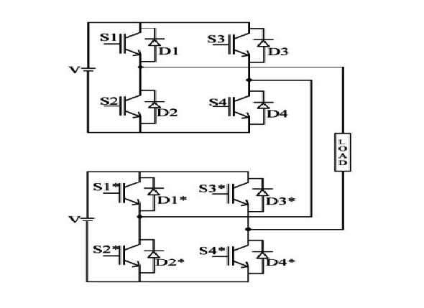
H-BRIDGE INVERTER CIRCUIT

Slide 8
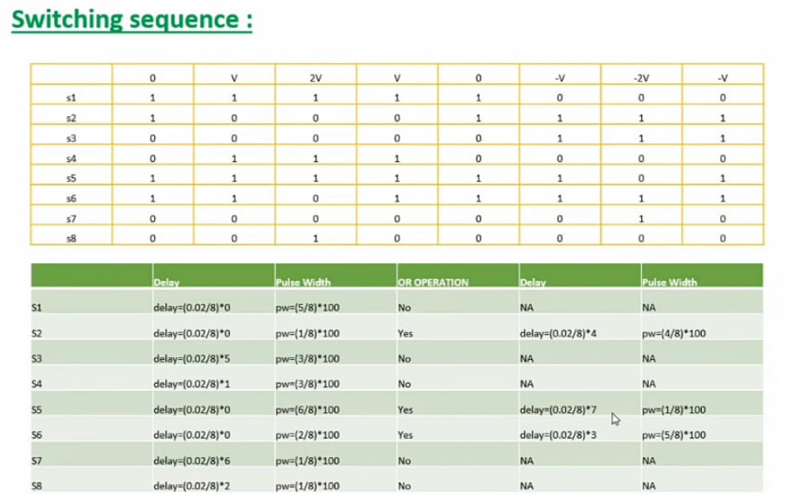
MOSFET IS USED AS THE SWITCH

Slide 9
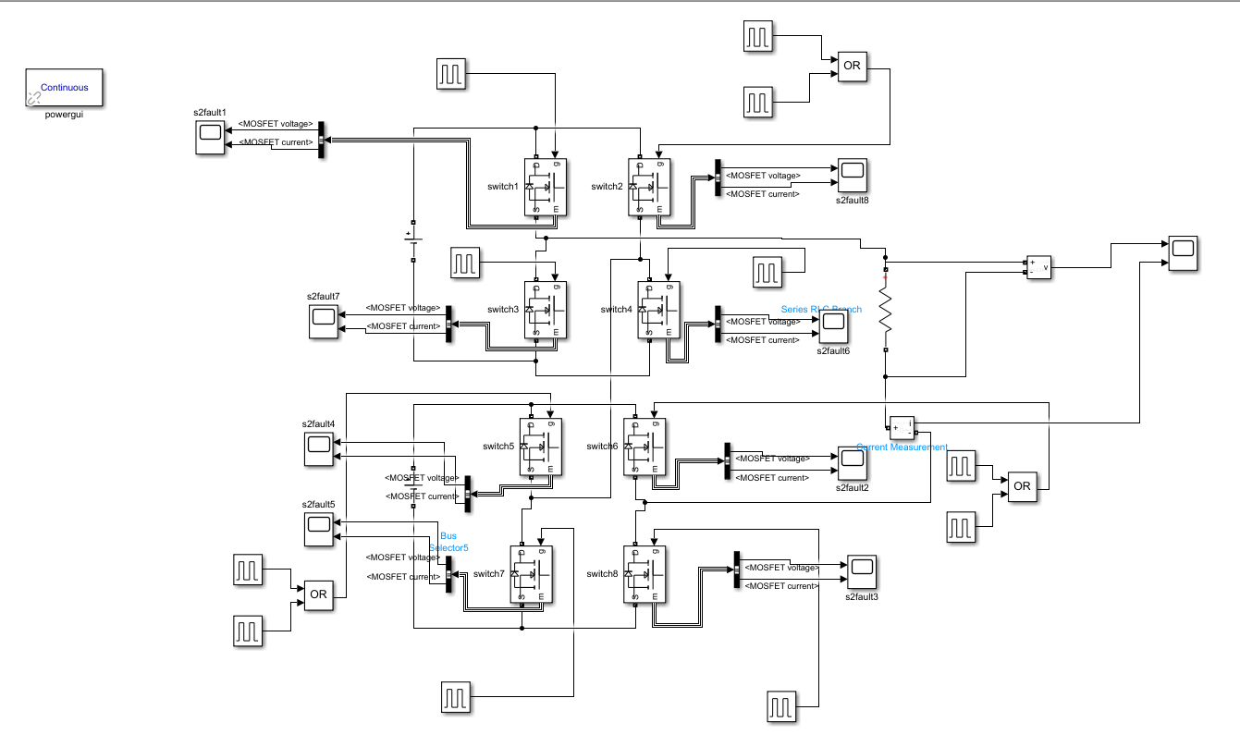
IMPLEMENTED IN MATLAB

Slide 10
SOFTWARE DESCRIPTION
MATLAB SOFTWARE
MATLAB is a programming and numeric computing platform used by millions of engineers and scientists to analyze data, develop algorithms, and create models.
MATLAB Capabilities
External language Interfaces - Use MATLAB with Python, C/C++, Fortran, Java, and other languages.
Data analysis - Explore, models, and analyze data.
Graphics - Visualize and explore data.
Programming - Create scripts, functions, and classes.
MATLAB in the cloud – Run in cloud environments from mathworks clouds
to public clouds including AWS and

Slide 11
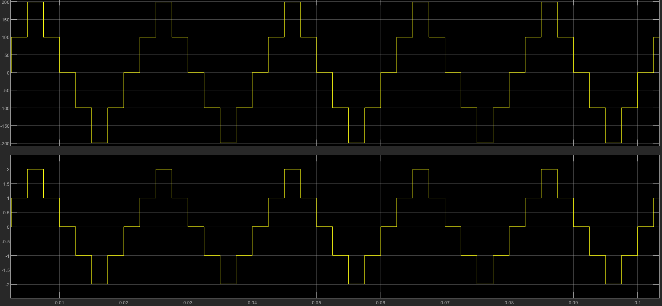
RESULT & DISCUISSION
5level Hbridge output in healthy state

Slide 12
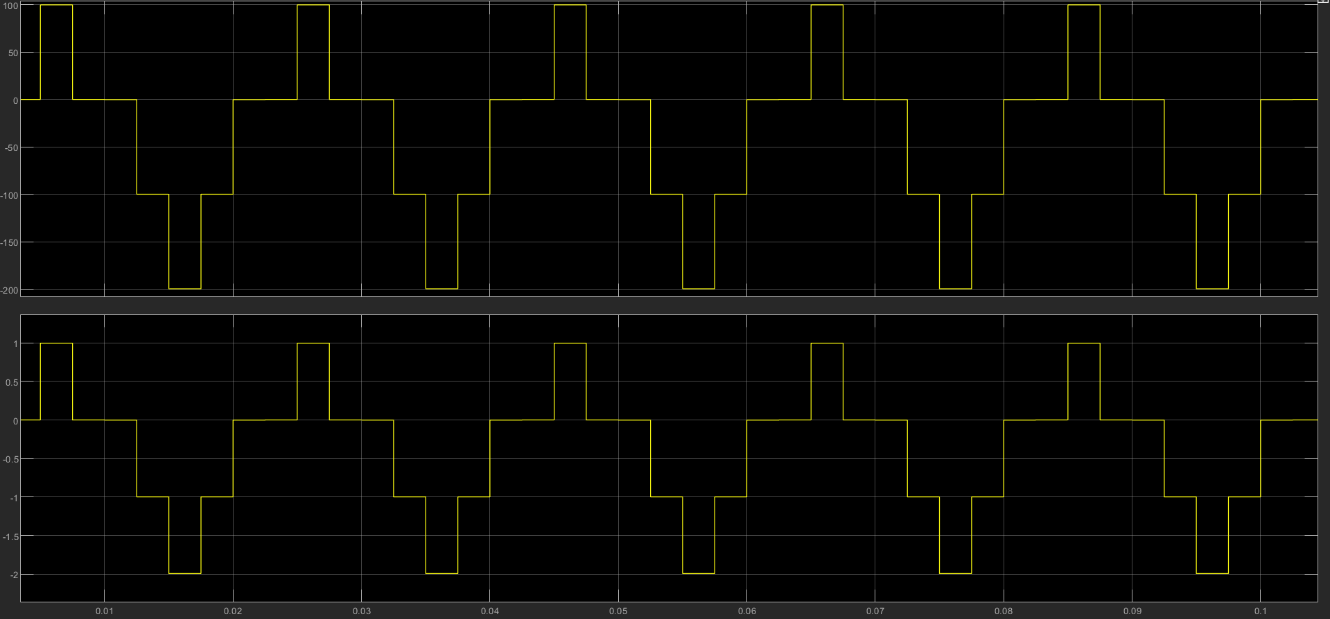
5level Hbridge output in fault state

Slide 13
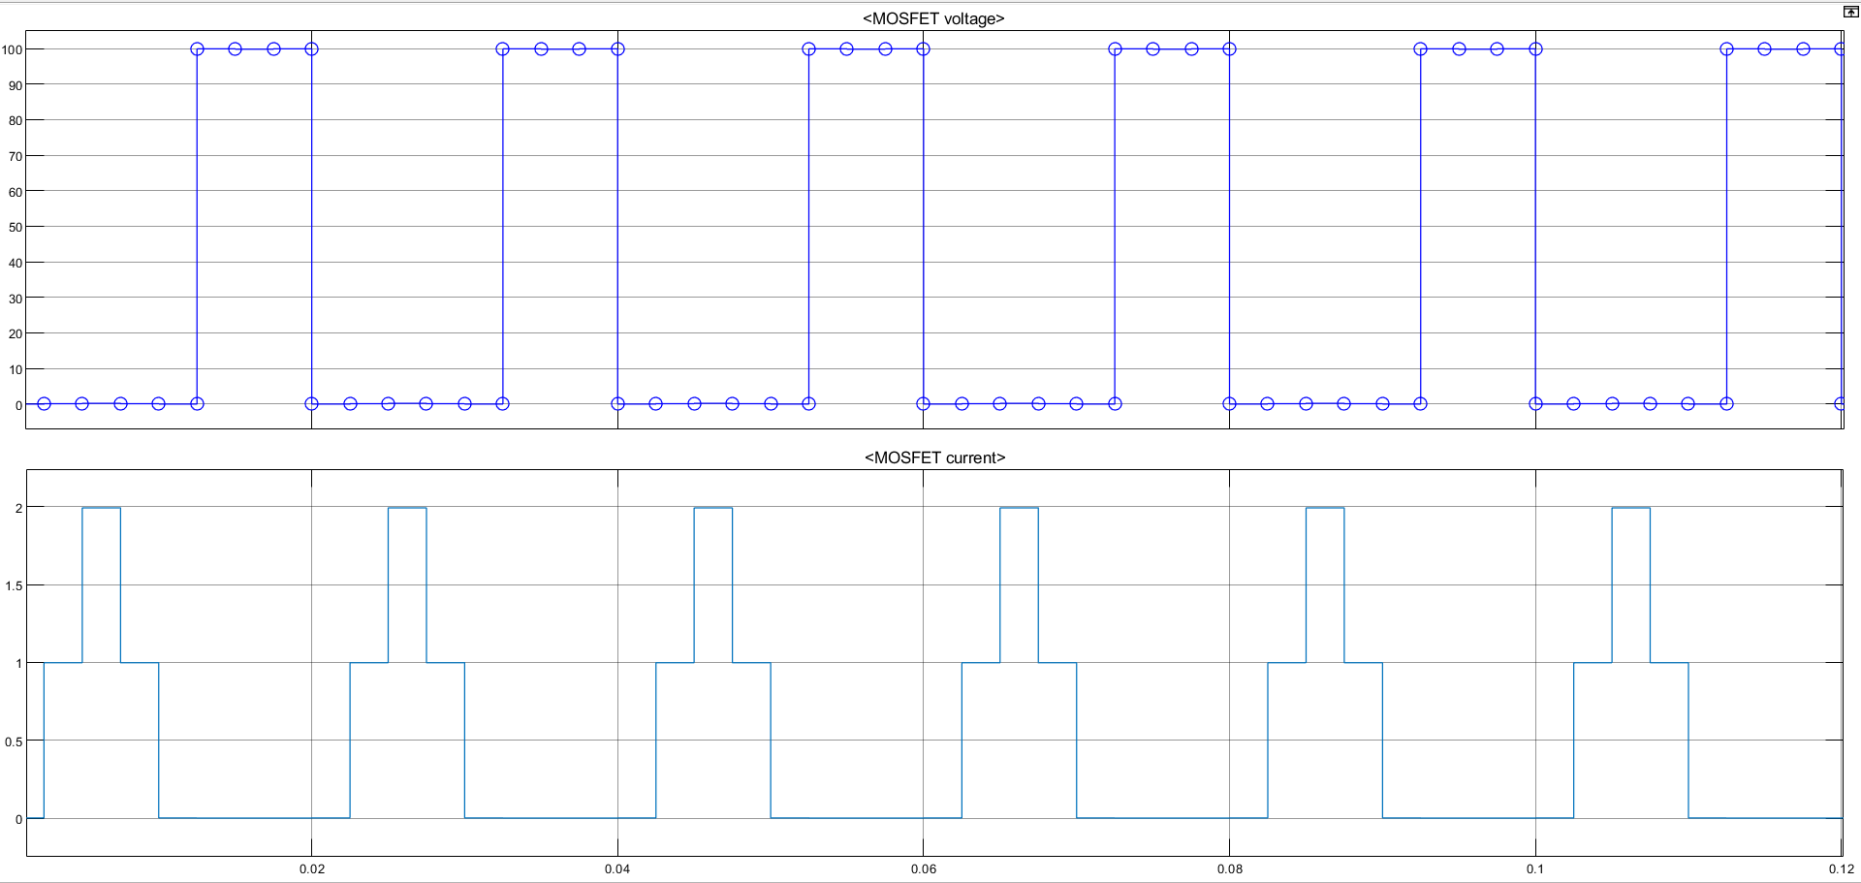
Mosfet voltage and current in circuit in healthy state

Slide 14
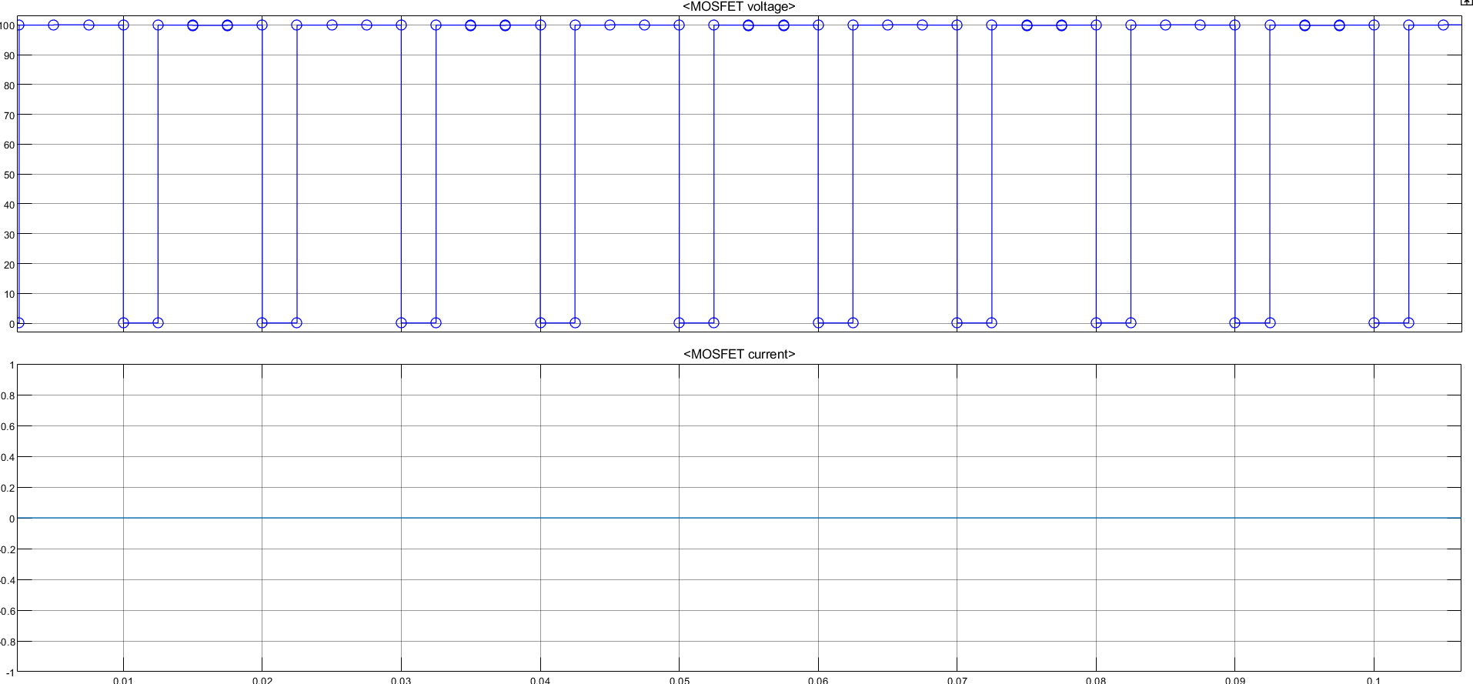
Mosfet voltage and current in circuit in fault state

Slide 15
MACHINE LEARNING PROCESS
1.Import the Data
2.Clean the Data
3.Split the Data into Training/Test sets
4.Create a Model
5.Train the Model
6.Make Predictions
7.Evaluate and improve

Slide 16
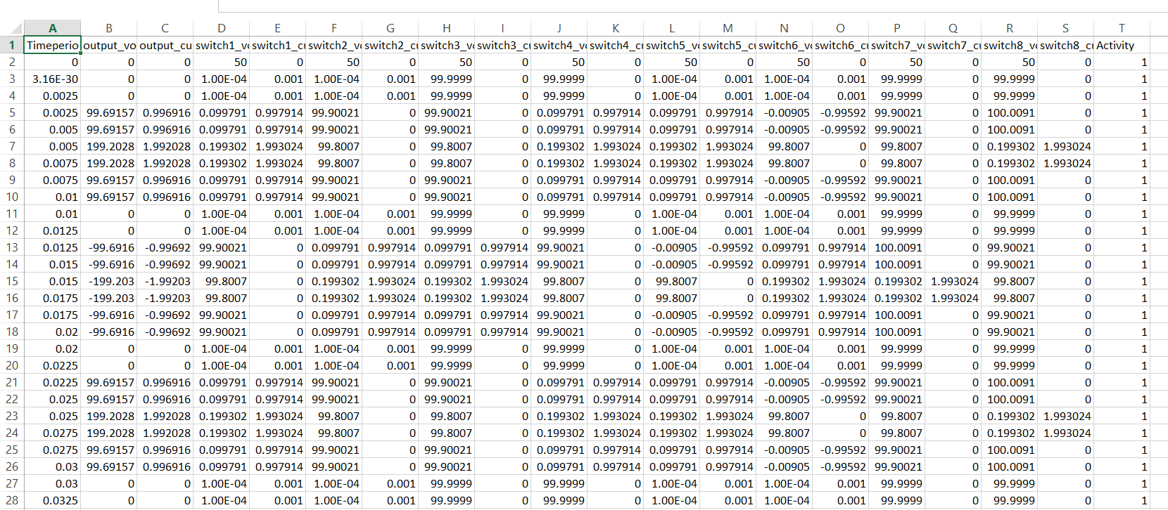
1.DATA ACQUISITION

Slide 17
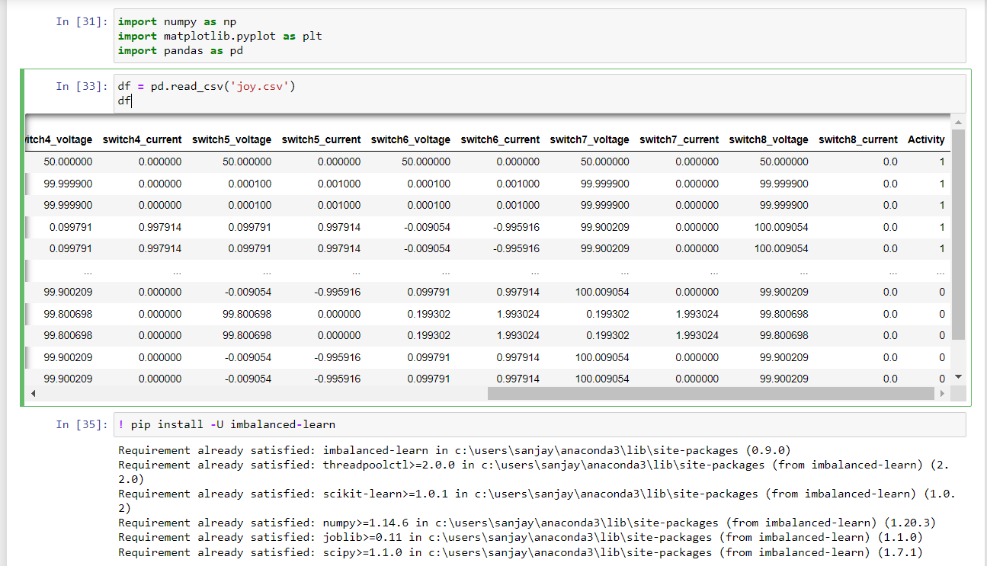

Slide 18
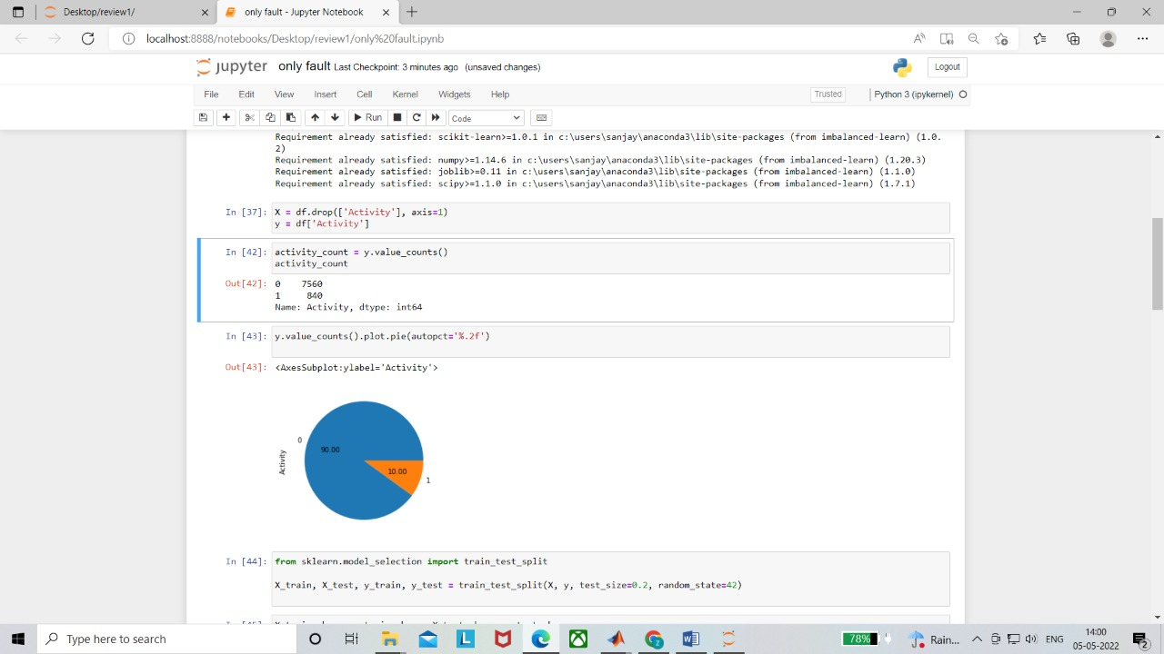
CLASS IMBALANCE

Slide 19
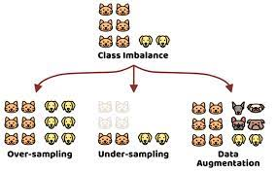

Slide 20
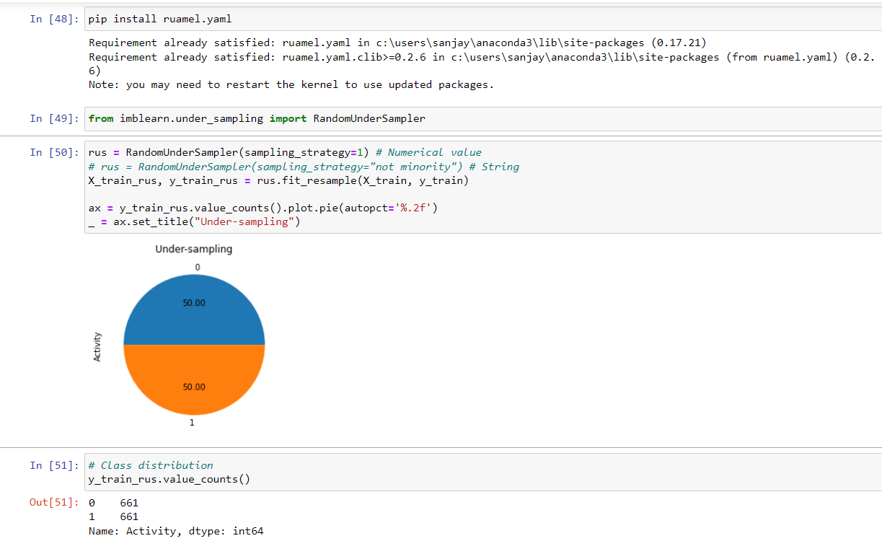
UNDERSAMPLING

Slide 21
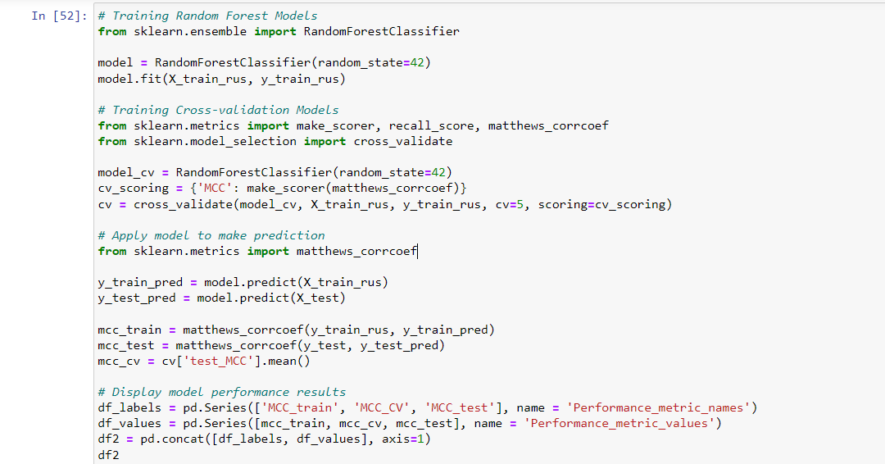


Slide 22
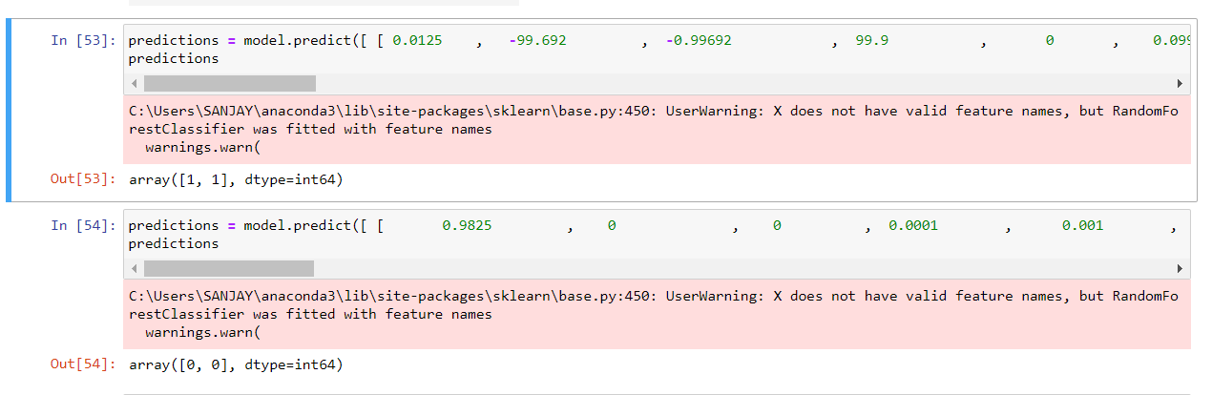
RESULTS

Slide 23
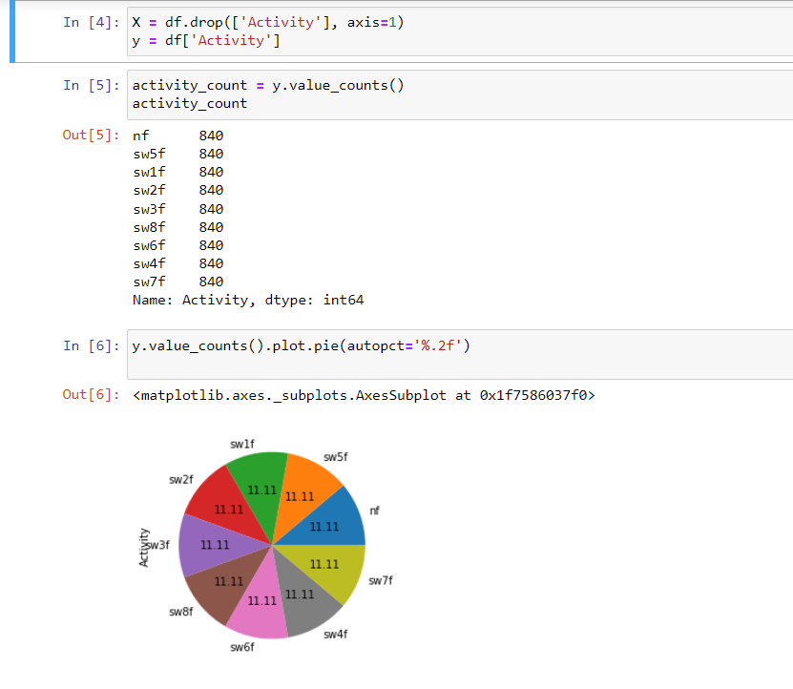

Slide 24
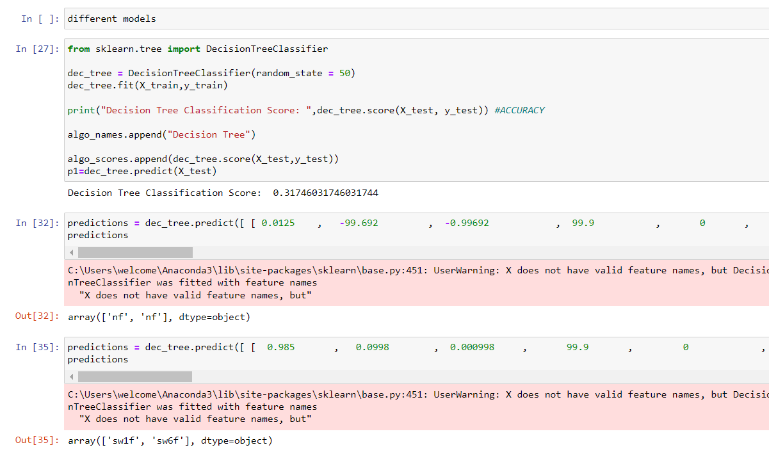

Slide 25
REFERENCE
1. Ali, M., Din, Z., Solomin, E., Cheema, K. M., Milyani, A. H., & Che, Z. (2021). Open switch fault diagnosis of cascade H-bridge multi-level inverter in distributed power generators by machine learning algorithms. Energy Reports, 7, 8929-8942.
2. N. Vichare and M. Pecht, “Prognostics and health management of electronics,” IEEE Transactions on Components Packaging Technology, vol. 29, pp. 291–296, 2006.
3. Babaei, Ebrahim, Sara Laali, and Zahra Bayat. "A single-phase cascaded multilevel inverter based on a new basic unit with reduced number of power switches." IEEE Transactions on industrial electronics 62.2 (2014): 922-929.
4. Achintya, Pratibha, and Lalit Kumar Sahu. "Open Circuit Switch Fault Detection in Multilevel Inverter Topology using Machine Learning Techniques." 2020 IEEE 9th Power India International Conference (PIICON). IEEE, 2020.
5. Wang, Tianzhen, et al. "Cascaded H-bridge multilevel inverter system fault diagnosis using a PCA and multiclass relevance vector machine approach." IEEE Transactions on Power Electronics 30.12 (2015): 7006-7018.

Slide 26
THANK YOU

